Slide 1
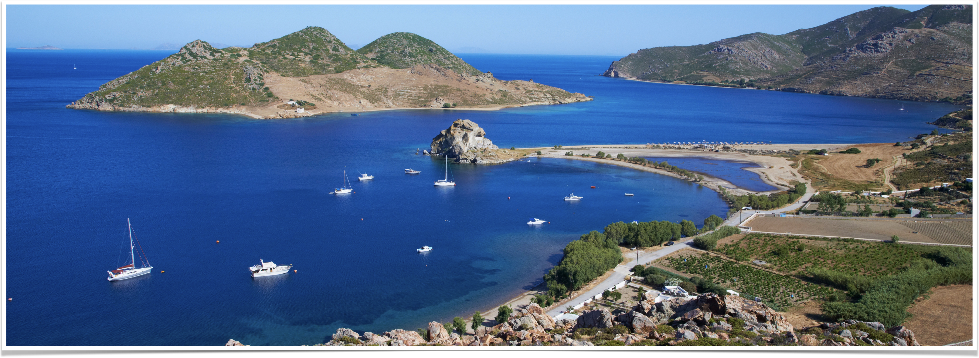
The Revelation of Jesus Christ
Vision 4, Part 1 (16:1-11) - Bowls 1-5

Slide 2
Summary of chapters 14-15
Those who are faithful to God during the apex of Catholic and Papal power will be saved
Those who complied with the Catholic Church will be condemned
God will pour out His judgment on the Catholic Church and its European allies in a series of judgments

Slide 3
Setting up the Bowls of wrath

Slide 4
1,260 years
First introduced in Revelation 11:2-3; repeated in 12:6, 12:14, and 13:5
Earlier interpretation
  Begins with Seal #6 (Constantine’s reforms) ends with Trumpet #6 (the Reformation)
  Roughly the 300’s to the 1500’s
  Represents the time of Catholic hegemony in Europe
Another possible interpretation

Slide 5
“Yielding honor to the Apostolic See and to Your Holiness, and honoring your Holiness, as one ought to honor a father, we have hastened to subject all the priests of the whole Eastern district, and to unite them to the See of your Holiness, for we do not allow of any point, however manifest and indisputable it be, which relates to the state of the Churches, not being brought to the cognizance of your Holiness, since you are the Head of all the holy Churches.”
–Emperor Justinian’s letter to Pope John II on March 15, 533

Slide 6
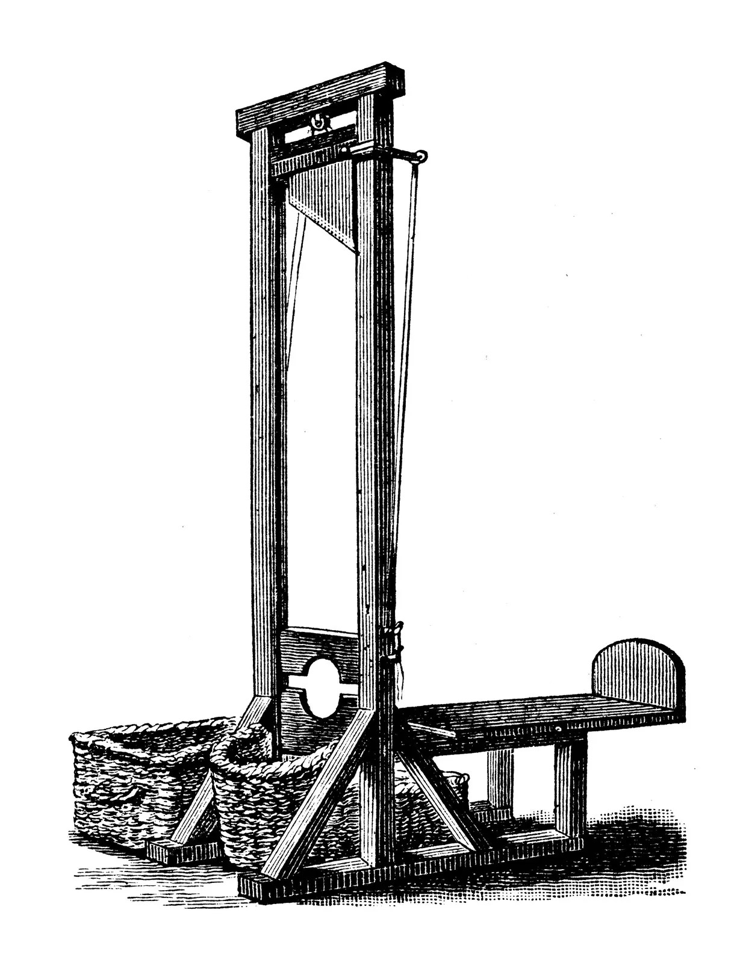
533 + 1,260 = 1793
What was happening in Europe in 1793?
The French Revolution: 1789-1799
1793-1795 - the “De-Christianization” of France

Slide 7
Revelation 16:2
So the first went and poured out his bowl upon the earth, and a foul and loathsome sore came upon the men who had the mark of the beast and those who worshiped his image.

Slide 8
What John Sees
Bowl is poured out “upon the earth”
  Earth (Bowl 1), sea (Bowl 2), rivers and springs (Bowl 3), and the sun (Bowl 4)
  Parallels the first four trumpets
A “foul and loathsome sore” — like an ulcer or a boil
It affects those who had “the mark of the beast and those who worshiped his image” - those aligned with the Catholic Church

Slide 9
France: the most Catholic nation
First Germanic power converted to Christianity (496, under Clovis I)
Beginning of the Holy Roman Empire under Charlemagne (i.e. the “image of the beast”)
French monarch known as the “Eldest Son of the Church”
France had the “mark of the beast” as much, or more, than any other nation in the world

Slide 10
Growing discontent with religion
Persecution of French Protestants since Reformation
Church held a monopoly over various institutions (e.g. hospitals and schools)
Catholic Church was the largest landowner in France
French nobility occupied highest seats of power within the Catholic Church
Widely-read French philosophers were critical of religion
Widespread atheism
Notes:
Persecuted French Protestants during the Reformation and later under Louis XIV
Church held a monopoly over various institutions (e.g. hospitals and schools)
The Catholic Church was the largest landowner in France
The upper echelons of the Church were occupied by French noblemen
Widely-read French philosophers were highly critical of religion
Voltaire, “Every sensible man, every honorable man must hold the Christian religion in horror.”
Diderot, “Man will never be free until the last king is strangled with the entrails of the last priest.”
Widespread atheism
“Famously, when dining in a large group with baron d'Holbach in Paris, Hume wondered whether there really were any atheists, ‘I've never met one,’ he said. To which the baron replied, 'You've been slightly unfortunate, for now here you are for the first time in your life surrounded by seventeen of them)!’”

Slide 11
The French Revolution - 1789-1799
An attempt to abandon religion in favor of reason and atheism
1791 - Civil Constitution of the Clergy
January 21, 1793 - King Louis XVI beheaded (Justinian 533 - King Louis XVI 1793)
1793-1795 - the De-Christianization of France
“...a foul and loathsome sore came upon the men who had the mark of the beast and those who worshiped his image.”
Notes:
The French Revolution - 1789-1799
Total abandonment of religion in favor of atheism; turns to the worship of Reason rather than the worship of God.
No moral inhibitions remained – vice and depravity reigned supreme
Other European nations still under the church of Rome's dominion would follow the example of France.
Ushers in a period of intense nationalism on the European continent.
1791 - Civil Constitution of the Clergy
An attempt to subordinate the French church to the state.
Limited the pope’s jurisdiction to spiritual affairs
Bishops and priests would be elected by citizens
The state would compensate the clergy
The number of bishops would be reduced from 135 to 83 and would report to a local government directory
Only 7 bishops and ½ of the parish priests took the oath; Pope Pius VI condemned the constitution
Jan. 21, 1793 - Louis XVI beheaded
Final French monarch to swear allegiance to the church put to death
Justinian letter to Pope John II, March 15, 533: “Yielding honor to the Apostolic See and to Your Holiness, and honoring your Holiness, as one ought to honor a father, we have hastened to subject all the priests of the whole Eastern district, and to unite them to the See of your Holiness, for we do not allow of any point, however manifest and indisputable it be, which relates to the state of the Churches, not being brought to the cognizance of your Holiness, since you are the Head of all the holy Churches.”
533 to 1793 = 1,260 years
1793-1795: Dechristianization of France
The church’s silver and gold were seized to finance the war efforts
The French word for Sunday (dimanche) was abolished
The Gregorian calendar was replaced by the French Republican Calendar that removed the Sabbath and saints’ days and stretched the seven-day week to 10 days
Religious holidays were banned
Churches were converted into “temples of reason” – by Easter, 1794, few of the 40,000 churches in France were open
20,000 priests were forced to abdicate and hand over their letters of ordination; 6,000-9,000 either agreed or were coerced to marry
By the end of the 1700’s, 30,000 priests had been forced to leave France, hundreds had been executed
“...a foul and loathsome sore came upon the men who had the mark of the beast and those who worshiped his image.”

Slide 12
Revelation 16:3
Then the second angel poured out his bowl on the sea, and it became blood as of a dead man; and every living creature in the sea died.

Slide 13
What John Saw
The second bowl is poured out “on the sea” - conflict at sea, naval warfare
  Second trumpet, Revelation 8:8 - the Vandals invasion of Italy from North Africa
It became “blood as of a dead man” - not red, but black; congealed
And “every living creature in the sea died”
  Contrasted with trumpet #3 where 1/3 of creatures died and 1/3 of ships destroyed
  Complete domination, destruction, annihilation

Slide 14
English naval dominance
11:13, “a tenth of the city fell” in the great earthquake — England departs from the Catholic Church in the Reformation
French army was led by brilliant generals; less formidable at sea
England was half the population of France; smaller, less effective army
Prime Minister Pitt built the greatest navy on earth to contain the French

Slide 15
Europe at war
1793
  February 1 - France declares war on Britain and Holland
  Britain forms a coalition with Portugal, Spain, Sardinia, Naples, Austria, Prussia, Russia
October 1796 - Spain leaves the coalition, declares war on Britain

Slide 16
England dominates the sea
February 14, 1797 - Spanish armada defeated by England; Britain gains control of the Mediterranean
October 21, 1805 - Nelson defeats the French Navy at Trafalgar
1807 — Britain blockades Europe
English naval power kept French militance in check

Slide 17
Revelation 16:4-7
Then the third angel poured out his bowl on the rivers and springs of water, and they became blood. [5] And I heard the angel of the waters saying: "You are righteous, O Lord, The One who is and who was and who is to be, Because You have judged these things. [6] For they have shed the blood of saints and prophets, And You have given them blood to drink. For it is their just due." [7] And I heard another from the altar saying, "Even so, Lord God Almighty, true and righteous are Your judgments."

Slide 18
What John Saw
The “rivers and springs…became blood” — military conquests along rivers
Parallel to Trumpet #3 - Attila the Hun
  Many major battles along the rivers of Central Europe

Slide 19
1796 - France invades Italy
Northern Italy filled with rivers fed by Alpine snowpack
First battles fought by Napoleon
  He intended to unite Europe into a single confederacy
Nursed an intense hatred of the papacy: he called it “the center of fanaticism”

Slide 20
The Cisalpine Republic
Merges Modena and Emilia with two territories of the Papal States, Bologna and Ferrara
Conquered territories are along the Po River Valley in Northern Italy
Later becomes the Italian Republic (1801) and later the Kingdom of Italy (1805)
Napoleon reduces the Papal States thus reducing papal power

Slide 21
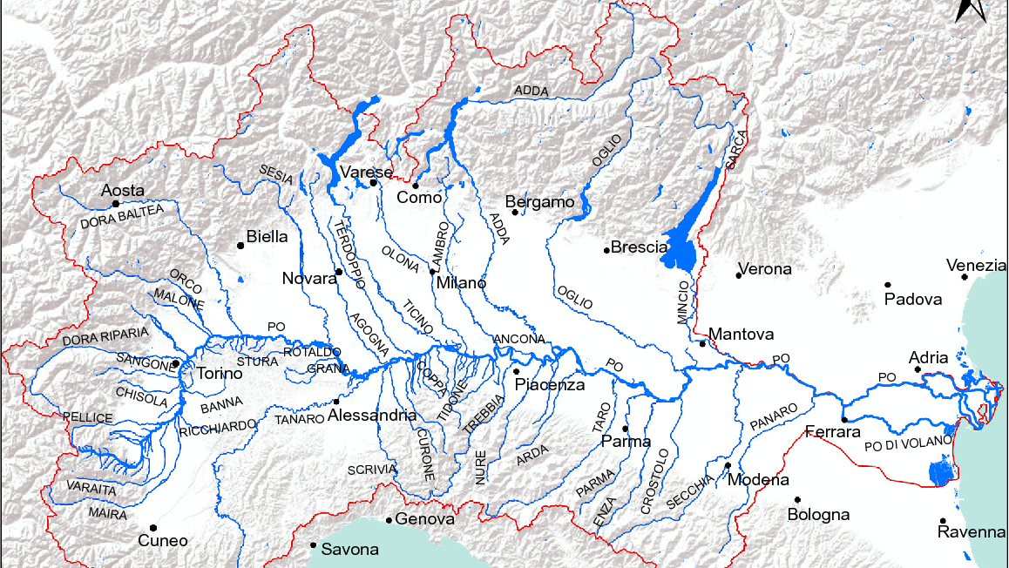

Slide 22
“And I heard the angel of the waters saying: ‘You are righteous, O Lord, The One who is and who was and who is to be, Because You have judged these things. [6] For they have shed the blood of saints and prophets, And You have given them blood to drink. For it is their just due.’ [7] And I heard another from the altar saying, ‘Even so, Lord God Almighty, true and righteous are Your judgments.’”
–Revelation 16:5-7
Notes:
Direct assault on the temporal power of the Catholic Church and the Papacy
Recompense for the centuries of corruption and persecution

Slide 23
Revelation 16:8-9
Then the fourth angel poured out his bowl on the sun, and power was given to him to scorch men with fire. And men were scorched with great heat, and they blasphemed the name of God who has power over these plagues; and they did not repent and give Him glory.

Slide 24
What John Saw
Bowl was poured out “on the sun” - the sun (or a star) represents an important ruler (e.g. Attila the Hun in 8:10-11 and Mohammed in 9:1)
The bowl gave the sun “power to scorch men with fire” - punishment
Parallel to Trumpet 4 which involved the heavenly bodies of the sun, moon, and stars

Slide 25
Napoleon vs. the Papacy
1797 - Napoleon sends his prospective brother-in-law, General Duphot, to Rome as an emissary
1801 - Concordant between France and the Papacy
December 2, 1804 - Notre Dame Cathedral
Relationship deteriorates further
1815 - Napoleon defeated at Waterloo
Notes:
1797 - Napoleon sends his prospective brother-in-law, General Duphot, to Rome as an emissary.
Duphot and Napoleon’s brother fomented an armed demonstration against the papacy; Duphot was shot and killed.
Napoleon sent an army to march on Rome; it took the city without opposition on February 10, 1798.
A new Roman Republic was declared and Napoleon demanded Pope Pius VI renounce his temporal authority; he refused.
Pope Pius VI was taken into custody, was poorly treated, and died in French custody in August, 1799; he was the longest serving pope at that time, having reigned for 24 years.
1801 - Concordat between France and the Papacy
Napoleon, “believed the reconciliation of Church and state necessary for reasons both of domestic harmony and of international solidarity.”
All clerics appointed and paid by the French government
Papacy validated all former church territory seized during revolution and bought by individuals later
Papacy given possession of papal states with exception of three territories: Ferrara, Bologna, and Romagna
Dec. 2, 1804 - Notre Dame Cathedral
Napoleon summoned the pope to Paris – every other emperor in the Holy Roman system since Charlemagne had gone to Rome to be crowned.
An artist had contrived a copy of Charlemagne's scepter; Napoleon is arrayed in royal attire.
Napoleon does not kneel down to receive blessings.
In front of cardinals and members of the royal court, Napoleon seizes the crown from the Pope, turns his back to him, and crowns himself and his kneeling wife.
Pope is publicly humiliated
The relationship further deteriorates in the years following
1805 - Napoleon appoints himself King of Italy
Feb. 2, 1808 - Rome occupied by French due to Pope's refusal to join the Continental system
May 17, 1809 Papal states declared incorporated with France
Pius excommunicates Napoleon as a result
Upon excommunication, Napoleon has Pius arrested
1815
Napoleon defeated by Wellington at Waterloo
Congress of Vienna: Napoleon's power broken, papal states restored to papal control.

Slide 26
“And men were scorched with great heat, and they blasphemed the name of God who has power over these plagues; and they did not repent and give Him glory.”
–Revelation 16:9

Slide 27
“I am convinced that the Catholic religion is the only one capable of making a stable community happy, and of establishing the foundations of good government. I undertake always to defend it .... I intend that [it] should be practiced publicly and in all its fullness .... France has had her eyes opened through suffering and has seen that the Catholic religion is her single anchor amid the storm. .”
–Napoleon to the Clergy of Milan, June 5, 1800
Notes:
After a decade of revolution, the French people grew weary of atheism
Growing sentiment to return to Catholicism
But the revolution set in motion the secularization of France — separation of church and state would be legislated in 1905

Slide 28
Revelation 16:10-11
Then the fifth angel poured out his bowl on the throne of the beast, and his kingdom became full of darkness; and they gnawed their tongues because of the pain. They blasphemed the God of heaven because of their pains and their sores, and did not repent of their deeds.

Slide 29
What John Saw
The fifth bowl is poured out on “the throne of the beast” — the seat of its power, where the beast reigned
Kingdom “became full of darkness” — like the ninth plague of Egypt
They “did not repent of their deeds” — no contrition, no change

Slide 30
The papacy loses the papal states
1821-1831 — Papacy reasserts itself, growing unrest among the Italian population against the Catholic Church
1831 — Papal States revolt
1831-1848 — unrest in Italy builds
1859-1860 — Italy unifies, Papal States seized
December 8, 1864 — Syllabus Errorum released
1871 - the Law of Guaranties
Notes:
1821-1831
Pope strives to re-establish influence in European courts
Growing unrest among Italian population against the church
1831
Revolts break out in Papal States
Order restored by Austria, France occupies until 1838 to maintain stability
1831-1848 - General unrest builds throughout Italy
1848 - Rebellion in Italy
The citizens of Rome rebel, drive Pope from the city and he is shut up in the Vatican for a time
The Italian government seized the property of the church; religious toleration is mandated
Apr. 12, 1850 - Pope returns to Rome, openly hostile toward liberal civil reform forces
1859-1860
Italy unified, Papal States seized
Having his temporal sovereignty limited, the Papacy seeks to strengthen its spiritual influence on the church.
Dec. 8, 1864 Release of the Syllabus errorum (see Langer, p. 664)
Papacy claims the church's, “control of all culture and science, and of the whole educational system; rejected the liberty of conscience and worship enjoyed by other creeds, and the idea of tolerance; claimed the complete independence of the church from state control...”
“It is an error to believe that the roman Pontiff can and ought to reconcile himself to, and agree with, progress, liberalism, and contemporary civilization.”
1871 The Law of Guaranties
Regulated the relationship between government and papacy
Papacy granted royal honors, freedom to perform all religious functions, visitors to Vatican granted diplomatic rights and privileges, provided an annual income from the Italian treasury.
This measure was rejected by the papacy until 1929.

Slide 31
Summary of 16:1-11
Bowls 1-4 represent France rebelling from Catholic Church
Bowl 5 represents Italy reducing the kingdom of the Papacy from the Papal States to the Vatican
In less than100 years, the Catholic Church (the beast) lost:
  Its closest ally in Europe, France
  The Holy Roman Empire (ended by Napoleon in 1806)
  Vast amounts of territory across Europe

Slide 32
What lies ahead
God’s judgment of the beast and false prophet concludes
  Bowl #6 - decline and fall of the Ottoman Turk Empire, groundwork laid for Armageddon
  Bowl #7 - the World Wars decimate the kingdom of the beast (Europe)
  Chapters 17-18 - reflections on Babylon
  Chapter 19 - Jesus defeats the beast and false prophet (Armageddon)
Chapter 20 - God defeats the dragon (Armageddon) and judges the world
Chapters 21-22 - Heaven

